Slide 1
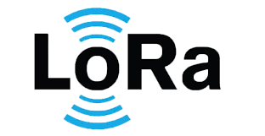
Livestock monitoring system
IoT-based Solution using TTGO LoRa32 Incorporates DHT11 (Temperature & Humidity), LDR (Light Intensity), and GPS NEO-6 for location tracking
By: sibuyi cs

Slide 2
Overview
Key Features:
Environmental monitoring (temperature, humidity, light).
Location tracking of livestock.
Wireless communication through LoRa technology.
Benefits:
Reduces manual efforts.
Improves livestock health monitoring.
Enhances farm productivity.

Slide 3
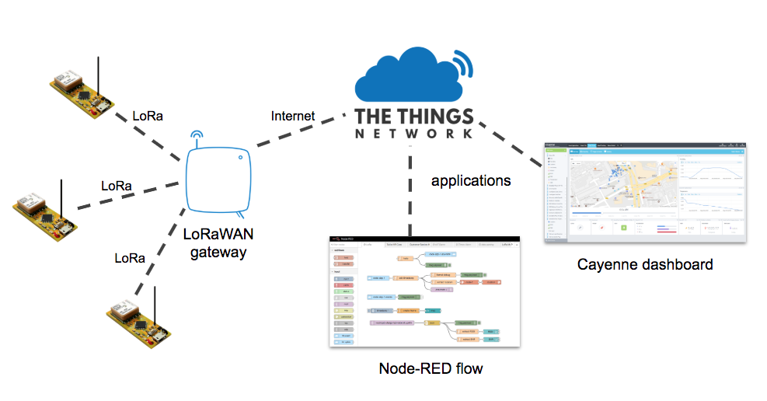
LORAWAN

Slide 4
Implementation & Applications
Implementation Steps:
Sensor integration with TTGO LoRa32.
LoRa configuration for data transmission.
Software setup for data logging and visualization.
Applications:
Health monitoring of livestock.
Detecting anomalies in environmental conditions.
Tracking livestock movements in large fields.

Slide 5
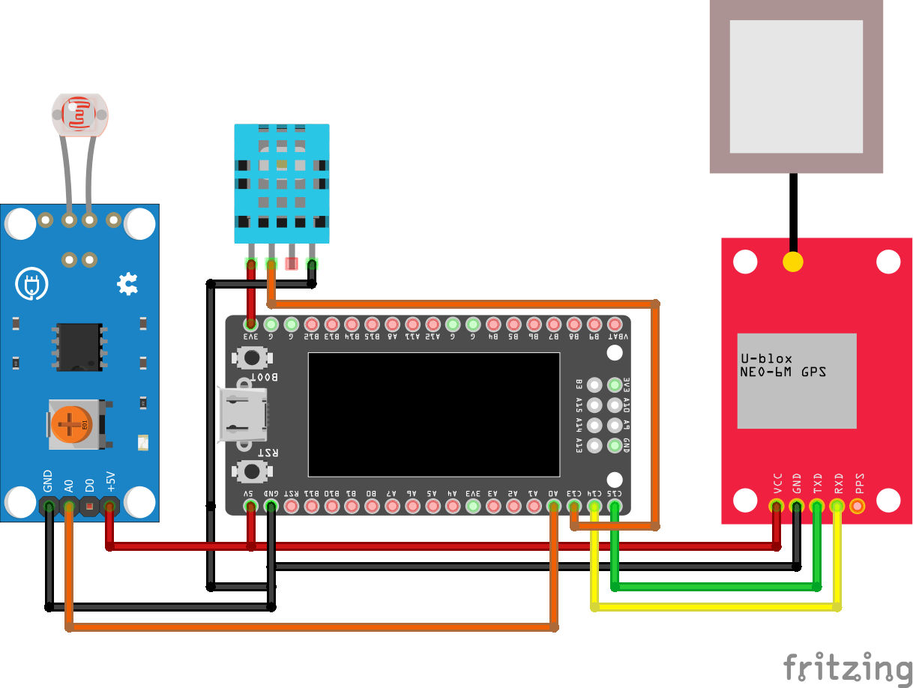
Hardware Components
SCHEMATIC
TTGO LoRa32:
Acts as the main controller and handles communication.
DHT11 Sensor:
Measures temperature and humidity.
LDR (Light Dependent Resistor):
Detects ambient light levels.
GPS NEO-6:
Provides precise location data.

Slide 6
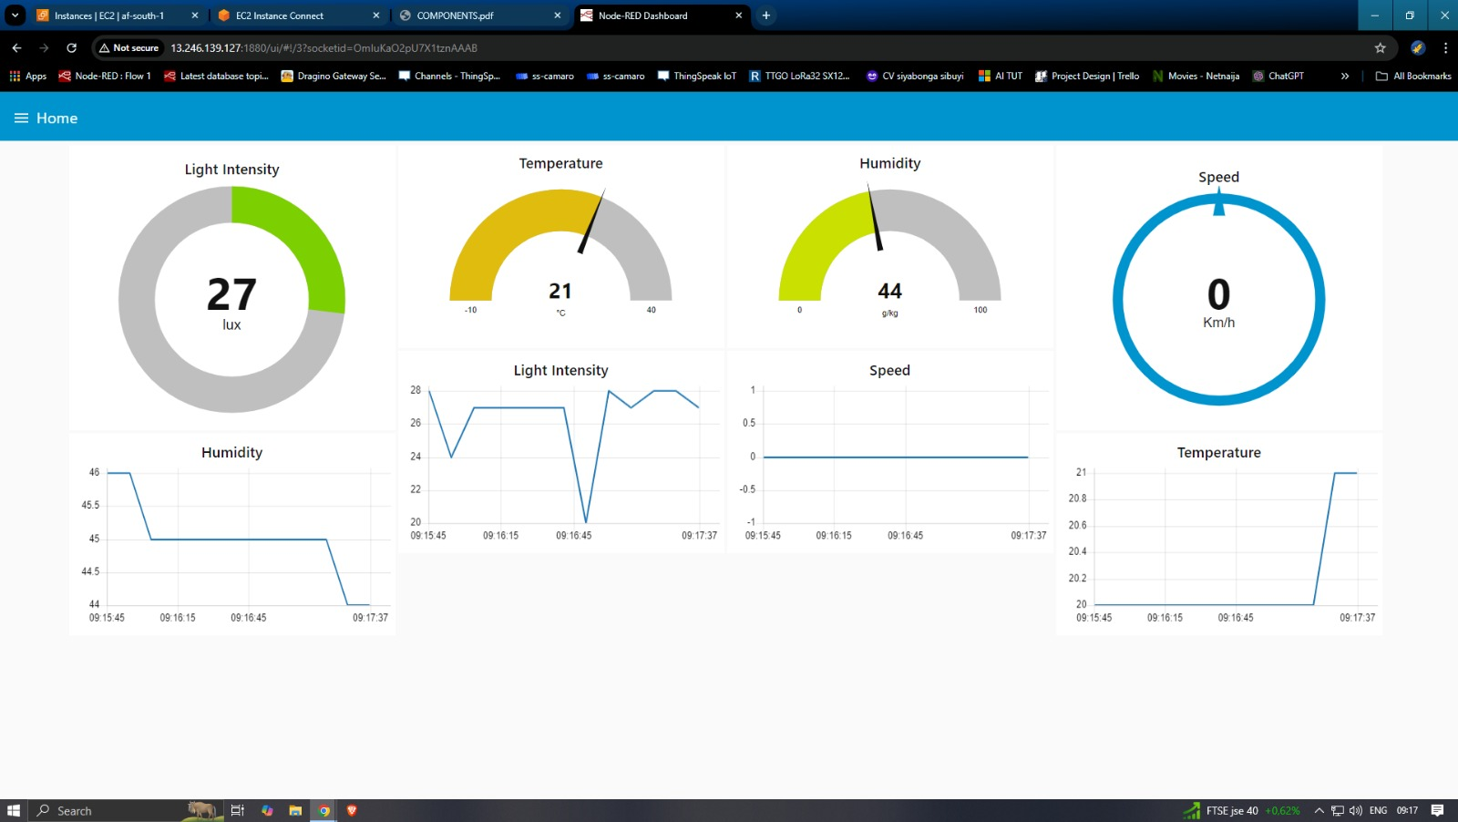
Node-red dashboard

Slide 7
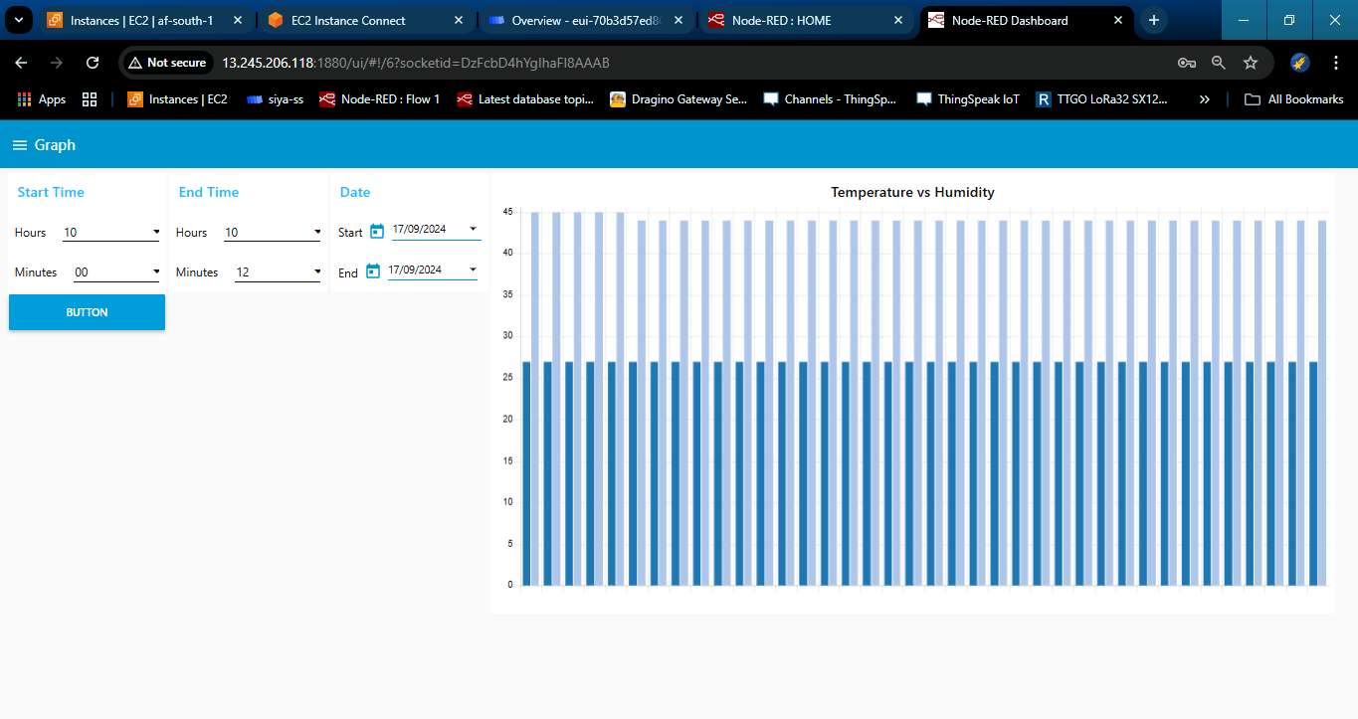
Node-red dashboard

Slide 8
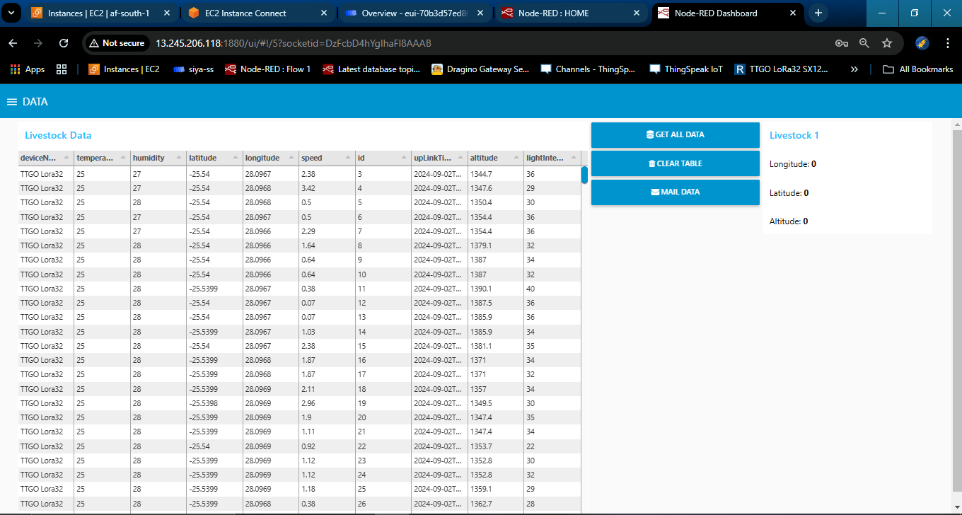
Node-red dashboard

Slide 9
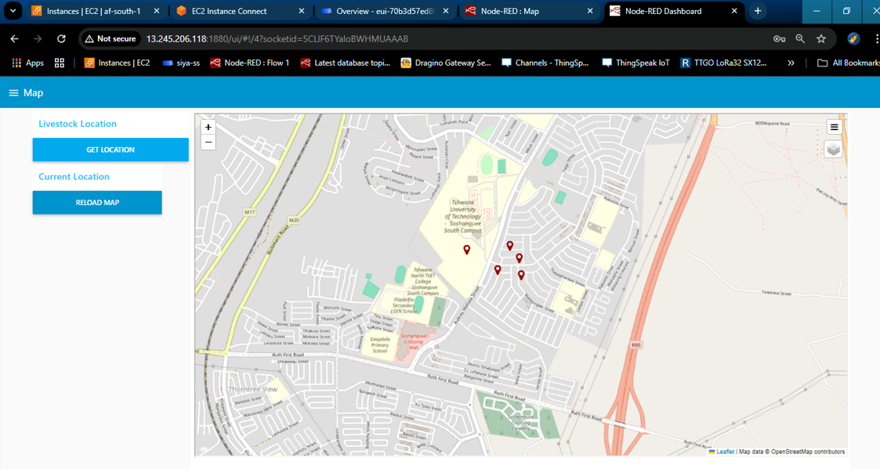
Node-red dashboard

Slide 10
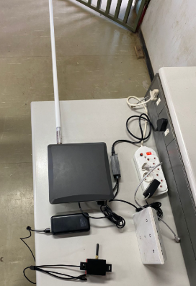
PROJECT

Slide 11
END
Questions?!

